Slide 1


Front slide option 2 – Static – can’t be changed
Tour of the Tidyverse
Andrew Little
Joe Russell

Slide 2
Agenda slide – orange block heights represents time spent on each section
In This Workshop, you’ll learn….
What the tidyverse is & why bother using it
What tools are available in the tidyverse
A brief overview of core functionality

Slide 3


Content slide
Image to right (sent to back)
What data are we using?
Funding of Olympic sports
UK Sport World Class Performance Programme
Data from Sydney (2000) to Rio de Janeiro (2016)
For the exercises:
uni_result.csv – received by email
Notes:
We’ll look at getting this data in to R a little bit later.

Slide 4


Image set to 80% transparency Layered on top of Gradient
Do not move logo
What is the tidyverse?

Slide 5


Do not move logo position
Full image slides, colour logo
Unified packages!
Packages that cover the data analysis workflow.
All built on the same principles.

Slide 6

Content slide
Image to right - Squared off / Coloured M logo
Tidy philosophy
Reuse existing data structures
Combine functions with the pipe
Embrace functional programming
Design for humans
Notes:
Breeze over this bit.

Slide 7
Do not move logo position
Full image slides, colour logo
Visualise
Import
Tidy
Transform
Communicate
Model
Program
Notes:
Process of working with data – the tidyverse is there to make this process as easy and as efficient as possible.

Slide 8

Section title – Flat colour – Image sent to back
What’s in the tidyverse?

Slide 9






Core packages
library(tidyverse) loads in the 6 core tidyverse packages:
There’s loads more of the ‘tidyverse-adjacent’ packages that are installed at the same time as the tidyverse.

Slide 10
Section title – Flat colour – Image sent to back
A Dive Into The Packages

Slide 11
Do not move logo position
Full image slides, colour logo
Visualise
Import
Tidy
Transform
Communicate
Model
Program

Slide 12
Import
readr
haven
httr
jsonlite
readxl
rvest
xml2
Notes:
Wide variety of files we might want to read in to R -> wide range of packages needed.
Haven – for spss/sas/dta data files
Httr – urls and http
Xml2 – xml files

Slide 13

Importing Tabular Data
read_csv(“path/to/file.csv”)
Other variants:
read_tsv
read_delim
Notes:
Really simple to read in tabular data, readr is the main package for that.
Just supply the path to the file you want read in and use the correct function depending on the file extension, csv, tsv, delim etc.
Show example using the SummerOlympicsFunding.csv – emphasise working directories.
Make sure to deal with the na’s when reading in.

Slide 14

Importing Data from MS Excel:
Use the readxl package
read_excel(“path/to/file.xlsx”,
sheet = “sheet 1”)
Notes:
Really simple to read in tabular data, readr is the main package for that.
Just supply the path to the file you want read in and use the correct function depending on the file extension, csv, tsv, delim etc.
Show example using the SummerOlympicsFunding.csv – emphasise working directories.

Slide 15
Content slide
Image to right - Squared off / Coloured M logo
Other cases
Use haven for spss/sas data
Use xml2 for xml files
jsonlite for json files

Slide 16
Exercise!
Read in the uni_results.csv using the appropriate package and function.

Slide 17
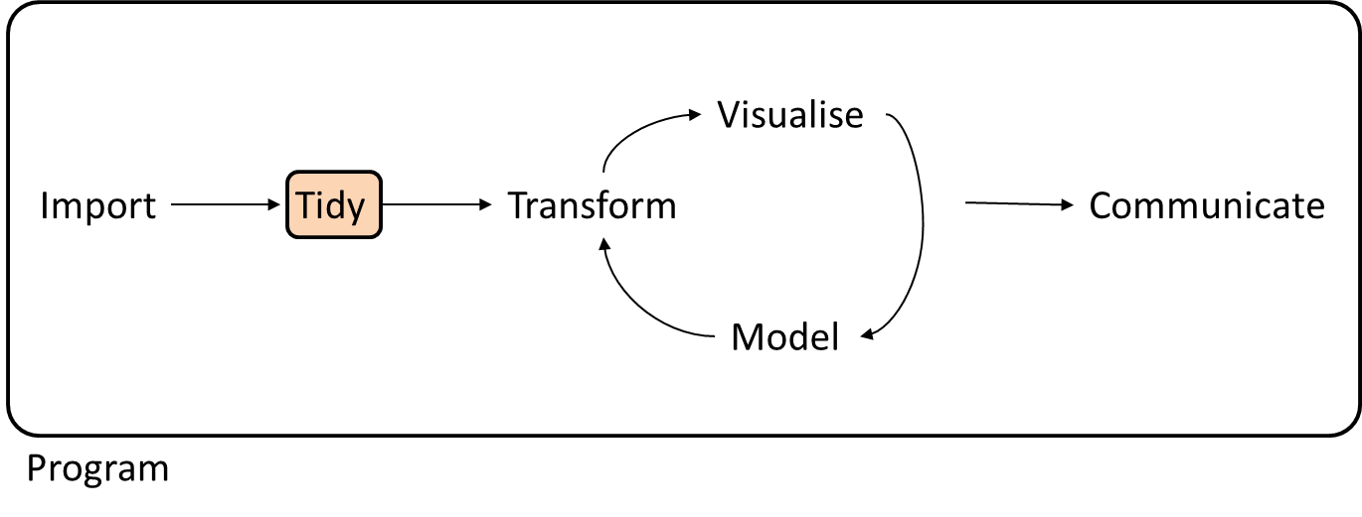
Do not move logo position
Full image slides, colour logo

Slide 18
Content slide
Image to right (sent to back)
Tidy
tibble
tidyr

Slide 19

tibble?
A tibble is an updated data frame
Can be created using the tibble package
Extra features:
Only prints top 10 rows
Doesn’t create row names – removes them if they’re already there
Character columns not converted to factor
Often created without you realising!

Slide 20
tibble functions
glimpse – useful overview of data
tibble/tribble – creation of tibbles
add_row/add_column – helpful functions for adding elements to an existing tibble
There are also a number of functions for converting rownames if needed
Notes:
Show examples after this

Slide 21
Creating a tibble Row-wise
years <- tribble(
~Location, ~Year, ~Month, ~Day,
"Sydney", 2000, 9, 15,
"Athens", 2004, 8, 13,
"Beijing", 2008, 8, 8,
"London", 2012, 7, 27,
"Rio de Janeiro", 2016, 8, 5
)
Notes:
In reality I’d create it using a data frame then convert to a tibble – show the two options.

Slide 22
Tidy data
The tidyverse is designed to work with tidy data
A single structure that is common to all of the packages
Makes it easy to move from manipulation to visualisation to modelling without changing the data

Slide 23
Content slide
Image to right - Squared off / Coloured M logo
Tidy Data Principles
Each variable has its own column
Each observation has its own row
Each value has its own cell

Slide 24
Using tidyr
tidyr is used to get our data to follow the tidy data principles.
pivot_longer – used to gather multiple columns into 1
pivot_wider – used to spread a single column across multiple
separate – separates a column into 2 columns

Slide 25
Content slide
Image to right (sent to back)
Tidying the Olympic
Data
summer <- pivot_longer(
data = summer,
cols = -Sports,
names_to = "Location",
values_to = "Funding")

Slide 26
Working with Missing Values
summer <- replace_na(summer,
replace = list(Funding=0))

Slide 27
Exercise!
Using the uni_results data that you read in during the last exercise, transform the data so that there is only one column of test scores. (Use the pivot_longer function)

Slide 28
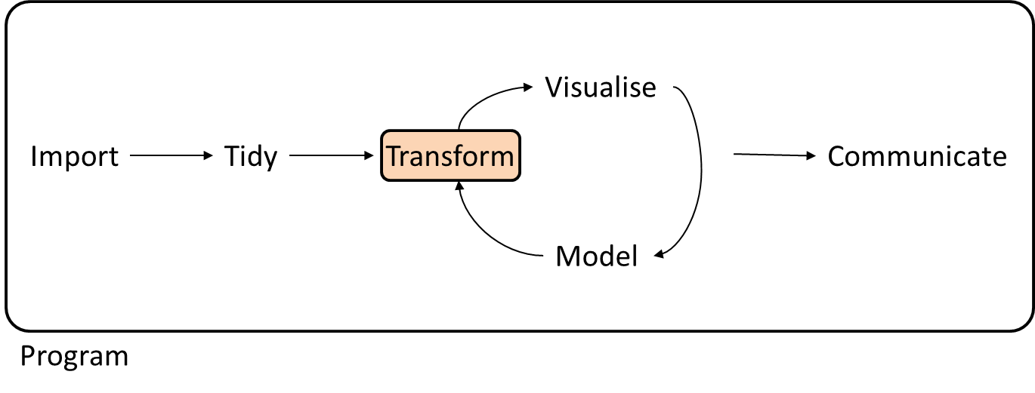
Do not move logo position
Full image slides, colour logo
Notes:
The tidying and transforming stages often overlap for me – the idea of tidying is getting the data in a universal format that can be reused, then you transform the data to carry out certain tasks, e.g. modify the data to create a plot.

Slide 29
Content slide
Image to right (sent to back)
Transform
dplyr
forcats
stringr
hms
lubridate

Slide 30

Data Manipulation with dplyr
5 main dplyr verbs:
filter
select
arrange
mutate
summarise
group_by allows actions to be performed by group
Notes:
Probably show off using the iris dataset

Slide 31
Filtering a dataset
noFunding <- filter(summer, Funding == 0)
First argument is the dataset
Followed by conditions to filter by

Slide 32
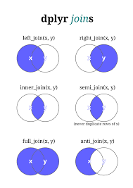
Joining related Data sets
dplyr provides functions for joining two data sets:
full_join
left/right_join
inner_join
anti_join
semi_join

Slide 33
Joining our summer and years data
summer <- full_join(summer, years)

Slide 34
Exercise!
Using the tidied uni_results data:
Obtain all the records corresponding to females
Sort the initial dataset by descending test_score
Find the mean test_score for test a and b for each course

Slide 35

Manipulating Factors: forcats
Factors are a representation of categorical data.
Forcats allows us to easily manipulate factors, you can:
Change names
Group levels
Reorder levels
Notes:
Show following slides before giving example of forcat usage.

Slide 36
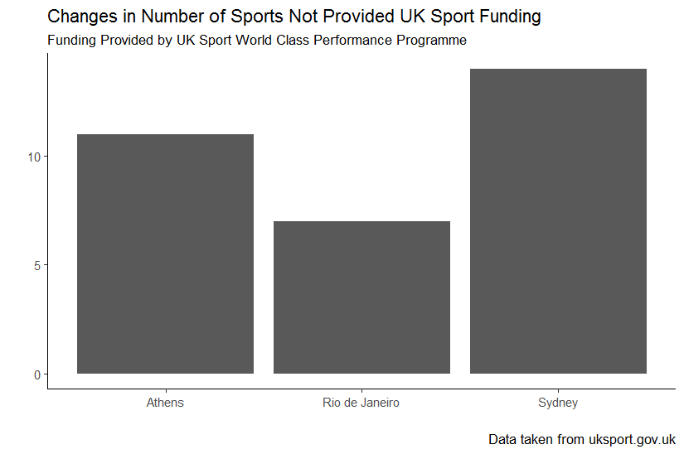
Do not move logo position
Full image slides, colour logo
Without Manipulation

Slide 37
Ordering the Location variable by Year
numberNoFund <- noFunding %>%
count(Location) %>%
left_join(years) %>%
mutate(Location = fct_reorder(Location, Year))

Slide 38
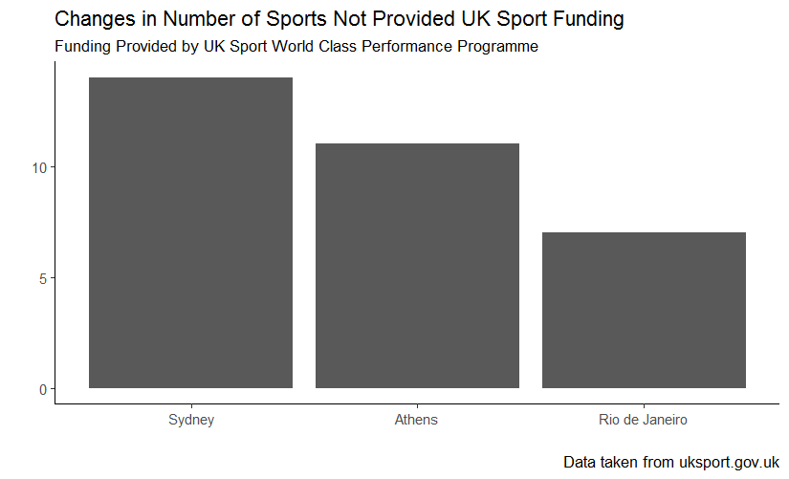
Do not move logo position
Full image slides, colour logo
With Manipulation

Slide 39

Manipulating Characters: stringr
stringr provides consistent functions for manipulating character strings
Manipulations include:
Concatenation
Pattern search and replace
Subset with strings
Notes:
Show following slides before giving example of forcat usage.

Slide 40

Manipulating Dates: lubridate
Easy to use functions to convert characters to date format:
ymd
mdy
dmy
Extract elements from dates
Arithmetic of time and dates

Slide 41
Creating Olympic Start Dates
summer <- mutate(summer,
Date = str_c(Year, Month, Day, sep = "-"),
Date = ymd(Date)
)

Slide 42
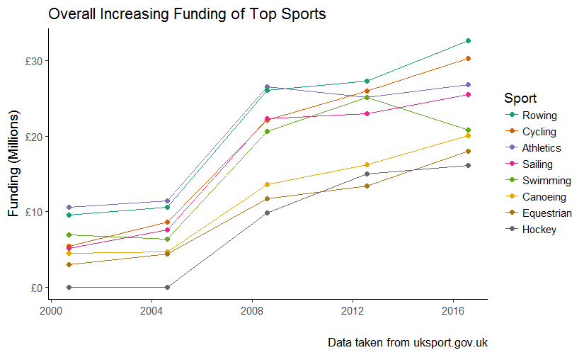
Do not move logo position
Full image slides, colour logo

Slide 43
Exercise!
Convert the test variable to a factor, rename the values to “A” and “B”.
Make sure that the graduation_date variable is indeed a date object. (You can check this using class(uni_results$graduation_date) )

Slide 44
Do not move logo position
Full image slides, colour logo
Visualise
Import
Tidy
Transform
Communicate
Model
Program

Slide 45
Content slide
Image to right (sent to back)
Visualise
ggplot2

Slide 46
Content slide
Image to right - Squared off / Coloured M logo
Creating graphics: ggplot2
Specify the type of plot using the geoms
Add titles and labels with ggtitle, xlab, etc..
Notes:
Flick back to graphics already created – probably the line chart

Slide 47
Using ggplot
ggplot(data = summer,
mapping = aes(x = fct_reorder(Location,Year),y = Funding, group = Sport, colour = Sport)) +
geom_line() +
ggtitle("Funding by Sport Over Summer Olympics") +
xlab(“Location of Olympics”) +
scale_y_continuous(labels = scales::comma)

Slide 48
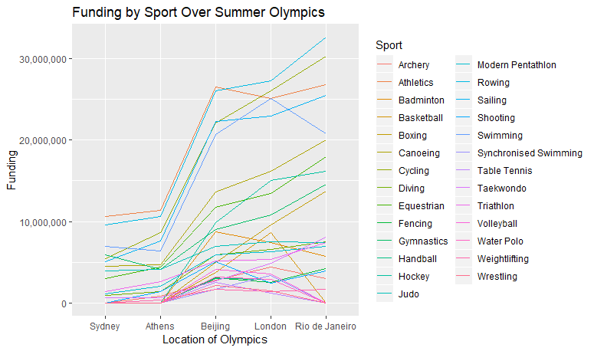
Do not move logo position
Full image slides, colour logo

Slide 49
geom_bar
ggplot(data = noFunding,
mapping = aes(x = Location)) +
geom_bar(fill = "lightblue") +
ggtitle("Counts of Sports with No Funding by Olympics") +
ylab("Number of sports without funding")

Slide 50
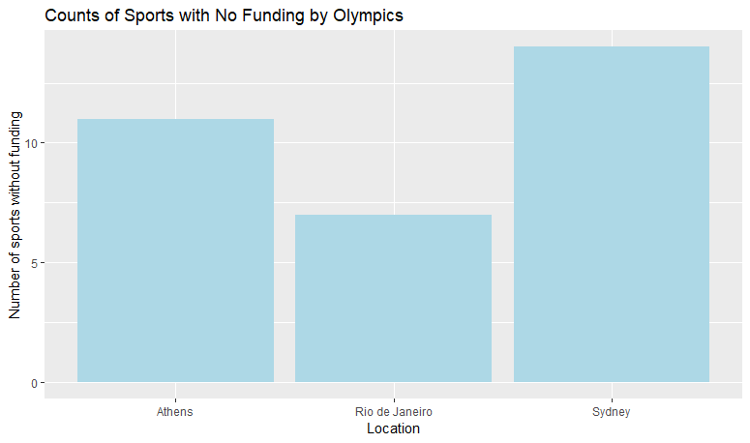
Do not move logo position
Full image slides, colour logo

Slide 51
Exercise!
Using the ggplot function, create a box plot of test_score by test.
Ensure the plot is well labelled
Colour the plot by course

Slide 52
Do not move logo position
Full image slides, colour logo
Visualise
Import
Tidy
Transform
Communicate
Model
Program

Slide 53

Content slide
Image to right (sent to back)
Model
modelr
broom
lm(data, y~x)

Slide 54
Do not move logo position
Full image slides, colour logo
Visualise
Import
Tidy
Transform
Communicate
Model
Program

Slide 55
Content slide
Image to right (sent to back)
Program
purrr

Slide 56

Iterating: purrr
Iterate (over a vector of values) or apply to multiple set/subsets of data
Output can be one of many types based on the function used:
map
map_df
map_dbl
…

Slide 57
Model For Each Sport
sportData <- summer %>%
group_by(Sport) %>%
nest()
sportsModels <- map(sportData$data,
~lm(Funding ~ Year, data = .))
sportResid <- map2_df(sportData$data,
sportsModels,
add_residuals, .id = "Sport")

Slide 58
Exercise!
Iterate over the mtcars dataset – finding the mean value for each column
For each course – find the variance (using the var function) of the test scores.

Slide 59
Do not move logo position
Full image slides, colour logo
Visualise
Import
Tidy
Transform
Communicate
Model
Program

Slide 60
Communicate
There are no tidyverse packages directly aimed at communicating results (other than creating graphics)
There are lots of packages that can be used to present results:
shiny
rmarkdown
flexdashboard
…
Notes:
Show off if there’s time at the end.

Slide 61
Section title – Flat colour – Image sent to back
Summary

Slide 62
Living in the Tidyverse
Single unified approach to manipulating and analysing data
Provides packages for all stages of the analysis lifecycle
Notes:
Show off if there’s time at the end.

Slide 63
More resources!
Rstudio Cheat Sheets: https://www.rstudio.com/resources/cheatsheets/
R for Data Science, Hadley Wickham & Garrett Grolemund, O’Reilly: http://r4ds.had.co.nz/

Slide 64
FINAL PAGE – PUT TO BACK OF DOCUMENT

